Slide 1

Programming Laboratory – V (SPOS) 18BTIS511 Assignment 1
Design suitable data structures and implement pass-I of a two-pass assembler. Implementation should consist of a few instructions from each category and few assembler directives.

Slide 2
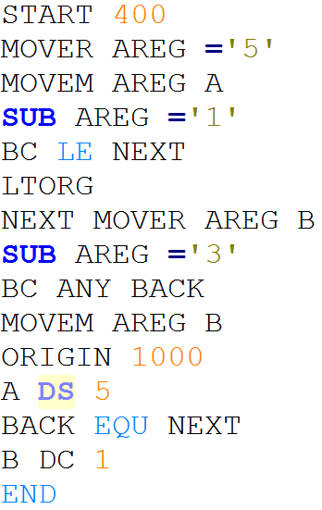
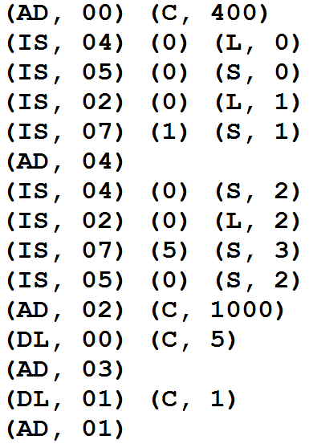

Slide 3
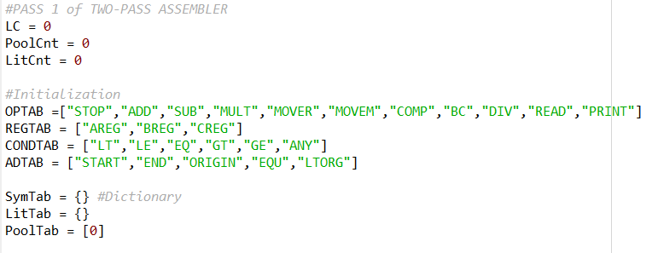

Slide 4
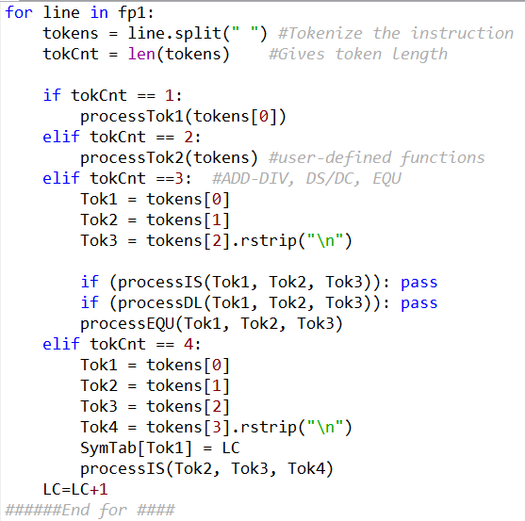

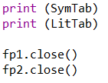
Definition – Tok1
Definition – Tok2
Definition – Tok3

Slide 5
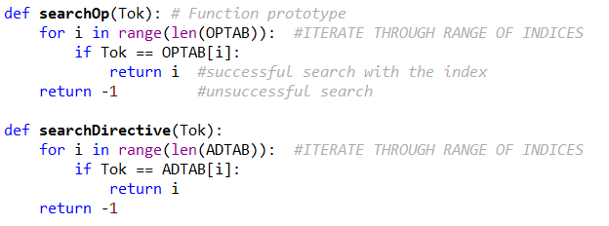
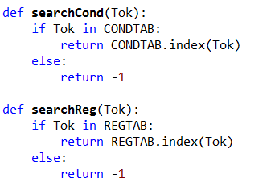

Slide 6
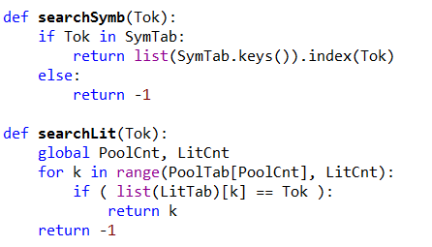

Slide 7
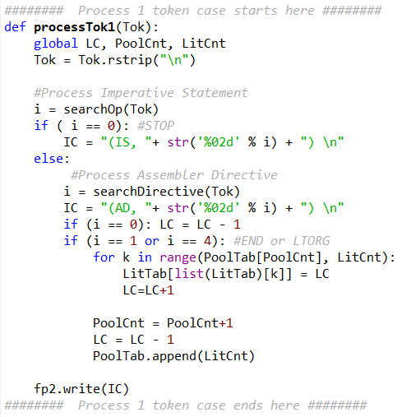
Back

Slide 8
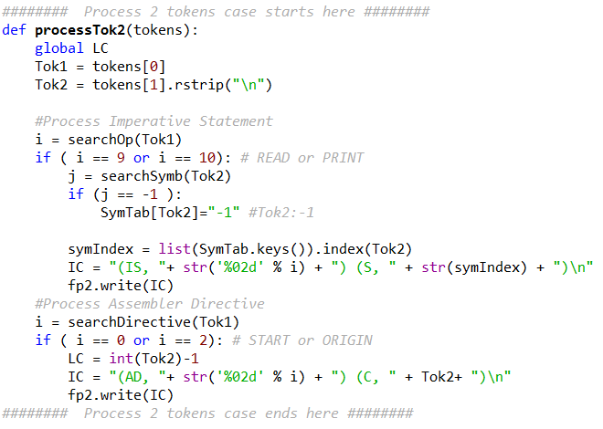
Back

Slide 9
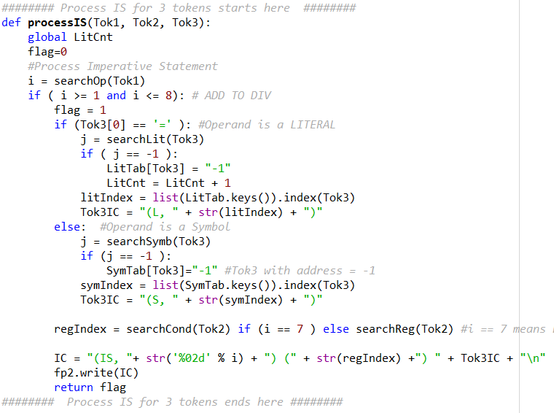
Back
Process DL and EQU

Slide 10
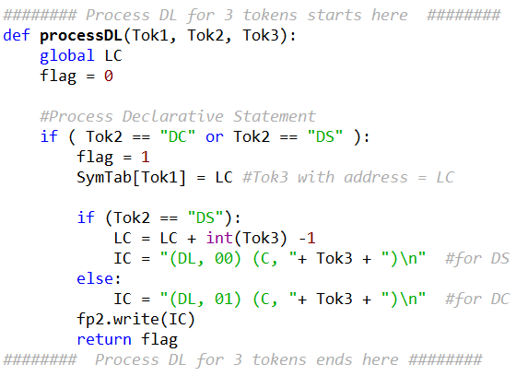
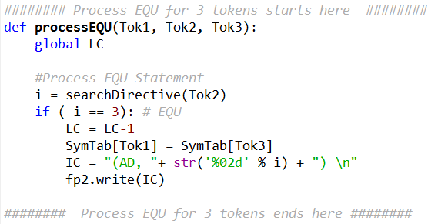
Back

Slide 11
Output
Symbol Table:
{'A': 1000, 'NEXT': 406, 'B': 1005, 'BACK': 406}
Literal Table:
{"='5'": 404, "='1'": 405, "='3'": 1006}
Pool Table:
[0, 2, 3]

